Slide 1
RxFx
David Paulsen
Notes:
Hi. My name is David and I’m going to tell you about RxFx.

Slide 2
We all have different needs.

Slide 3
Finding the right R_{x} is costly in terms
of both time and comfort.

Slide 4
RxFx
Notes:
RxFx aims to provide people with recommendations that are personally tailored to the side effects they are most wanting to avoid.

Slide 5
Data Source
openFDA database:
3 million records self- or physician-reported entries from around the world
more than 320k drug listings
16k side effect listings
13k indications (e.g. anxiety, depression)

Slide 6
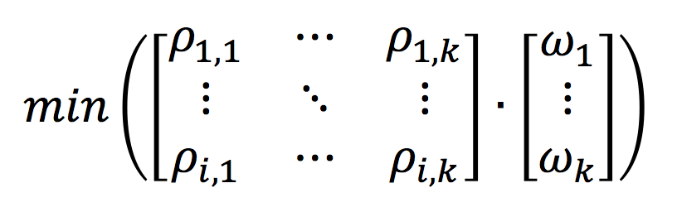
Data Pre-processing
reduced ~320k drug listings to ~90k
grep & python pattern replacement, n-gram similarity
probability of side-effect_{k} for drug_{i} =
# patients reporting side-effect_{k} /
# patients reporting any side-effect_{k}
where ϖ = inverse of rank ordering preferences 1-k and
ρ_{i,k} = probabilities of side effects 1-through-k for drug i.
Recommendation =

Slide 7


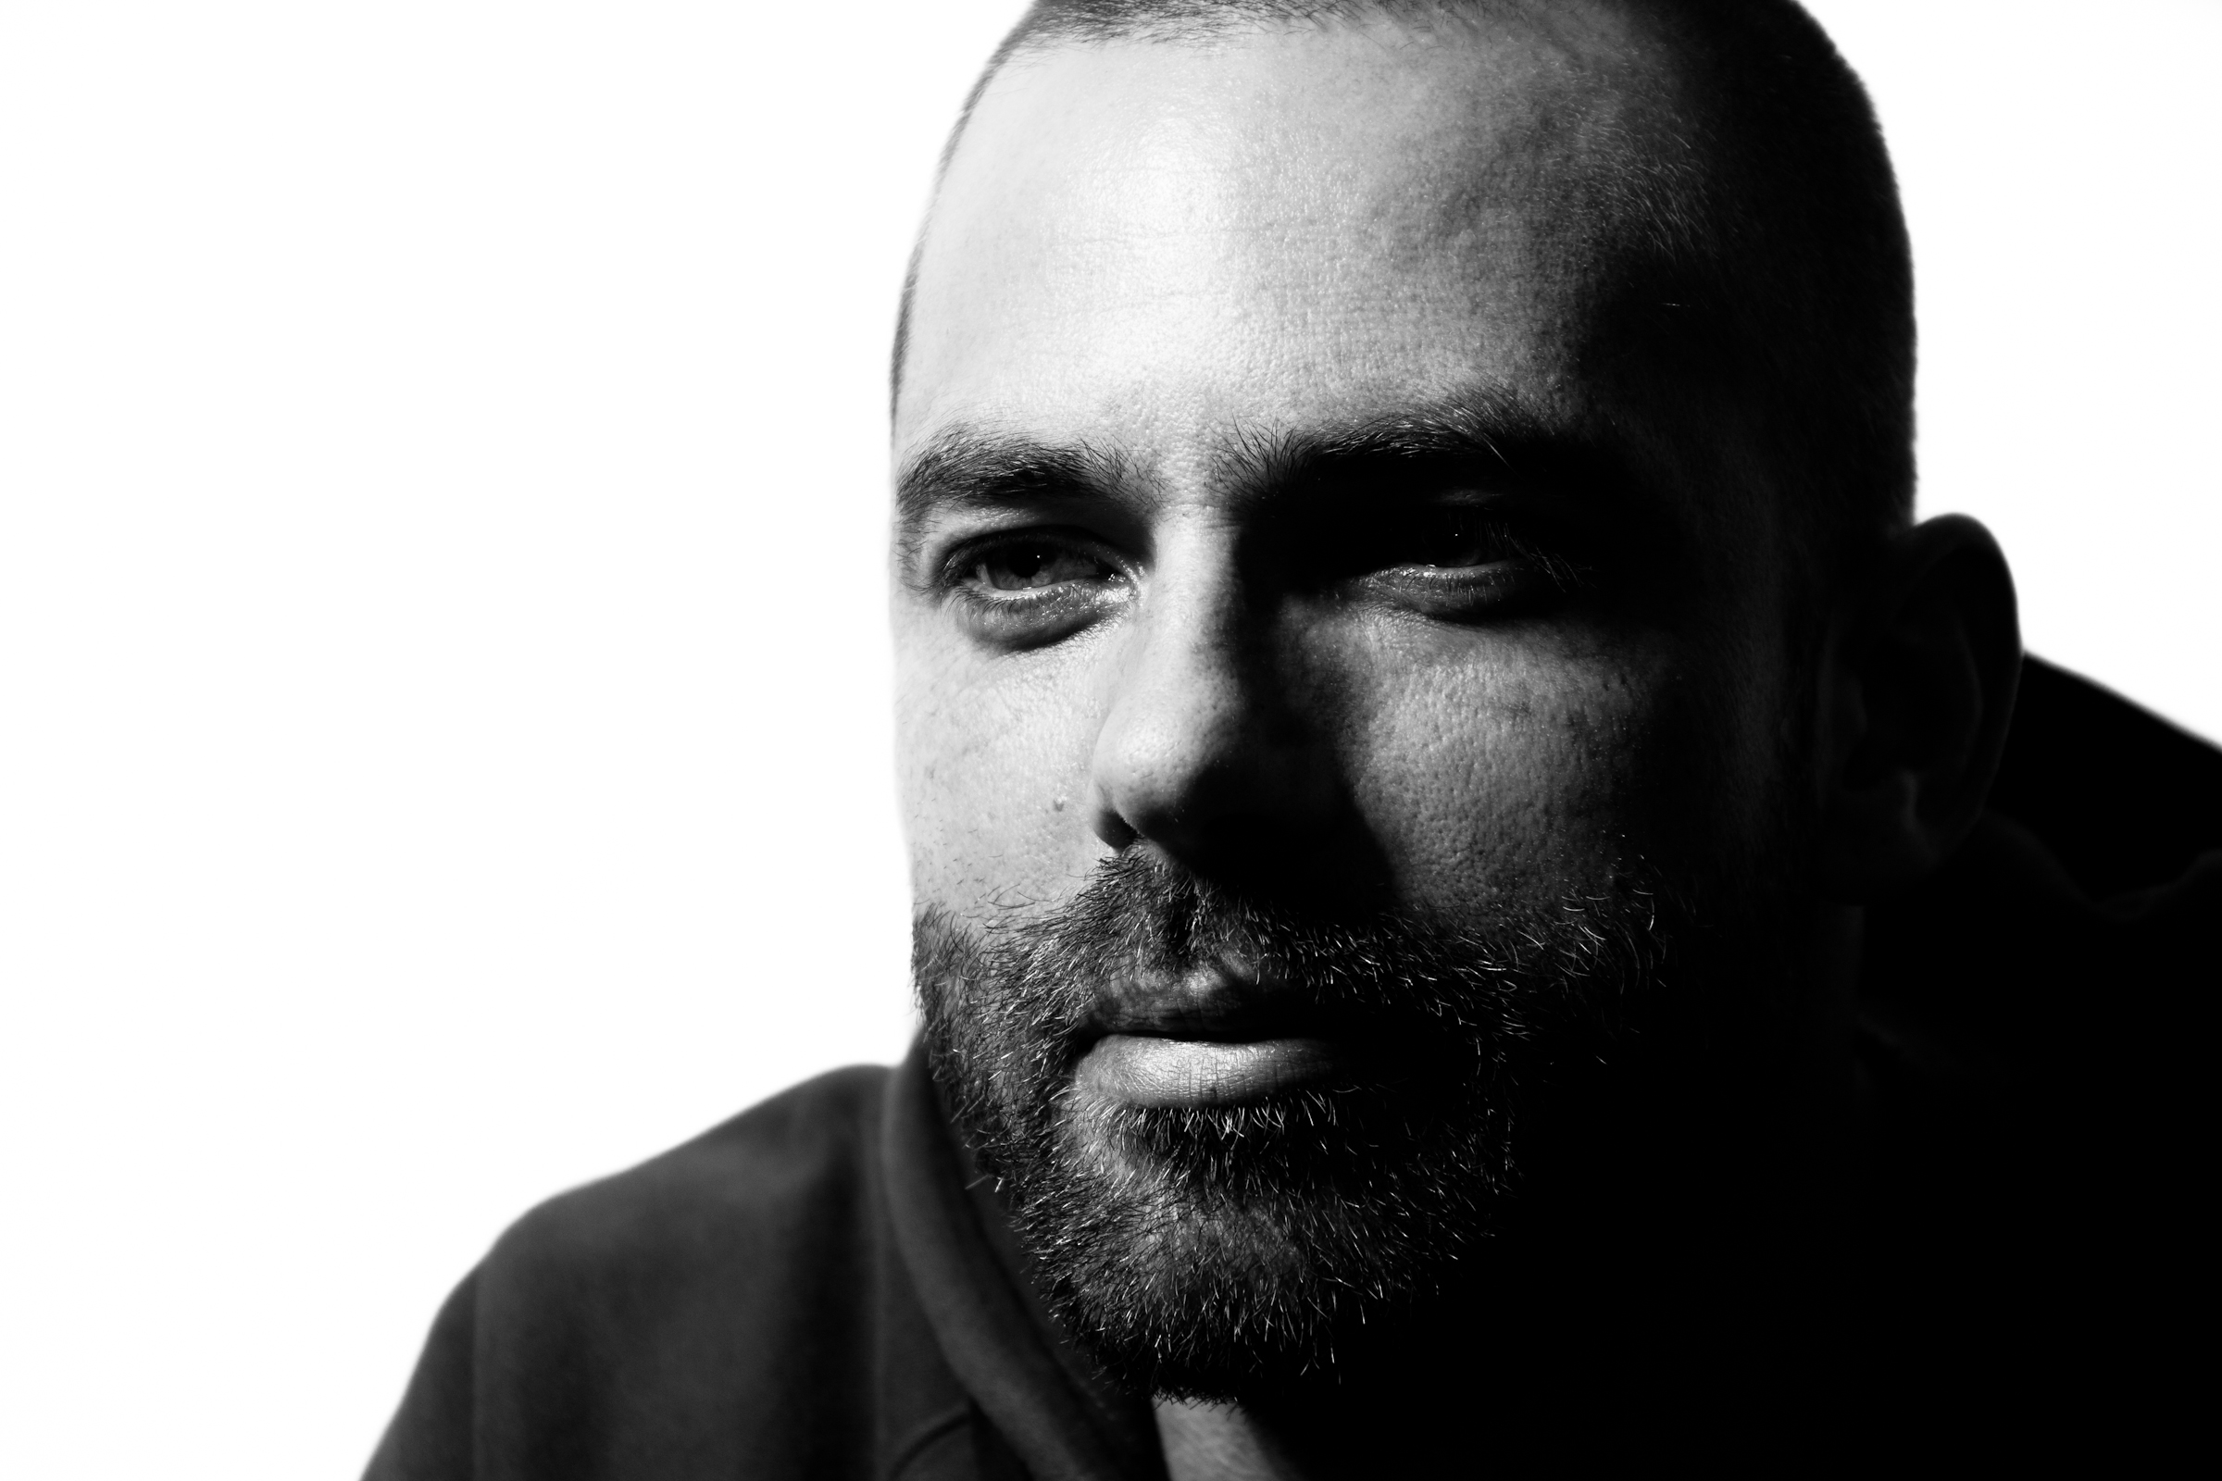

David J. Paulsen
Duke University
Center for Cognitive
Neuroscience
University of Pittsburgh
Medical Center
Development of
Risky Decision Making

